Slide 1
Good Flight (PID) – Test 8 – Old Folder - 189.bin
Pitch: P=0.1, I=0.02, D=0.01

Slide 2
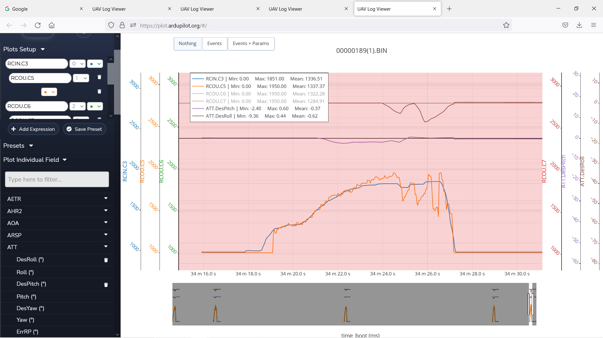
Notes:
Back Motor – Track Throttle – Track Inv DesPitch

Slide 3
Notes:
Right Front Motor – Track Throttle – Track DesPitch – Track Inv DesRoll

Slide 4
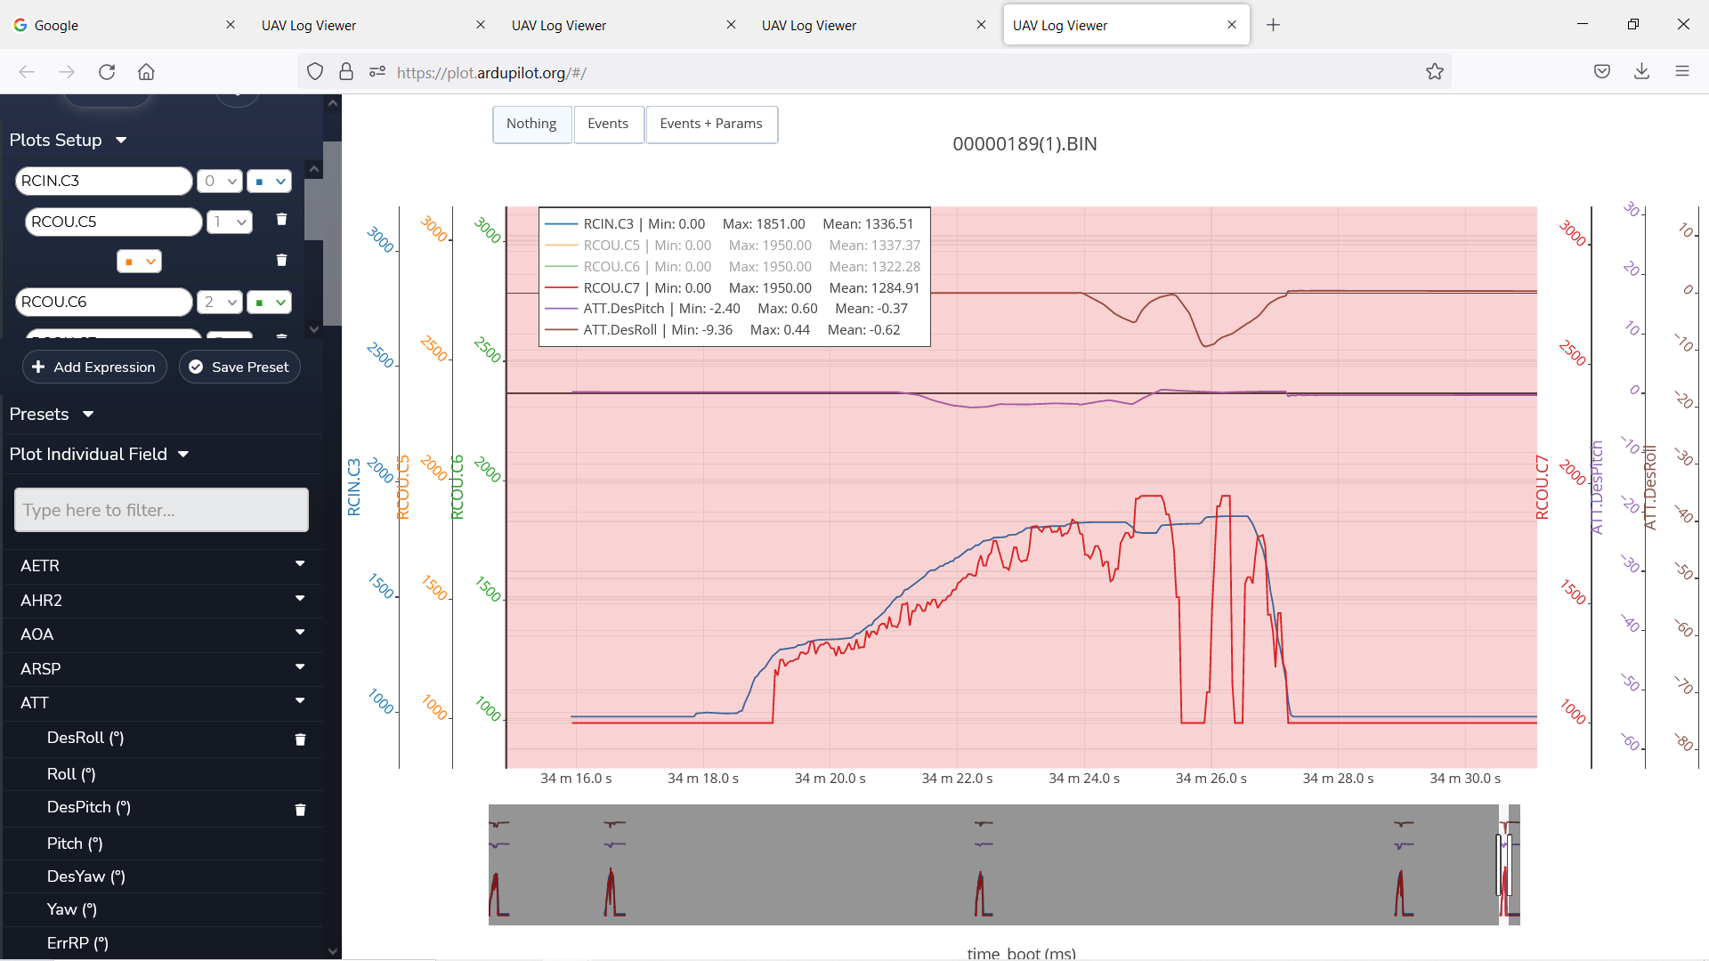
Notes:
Left Front Motor – Track Trottle –Track DesPitch – Track DesRoll

