Slide 1
IPD – Test 30 – Old9 folder – 46.bin
Pitch: P=0.3, I=2.0, D=0.005

Slide 2
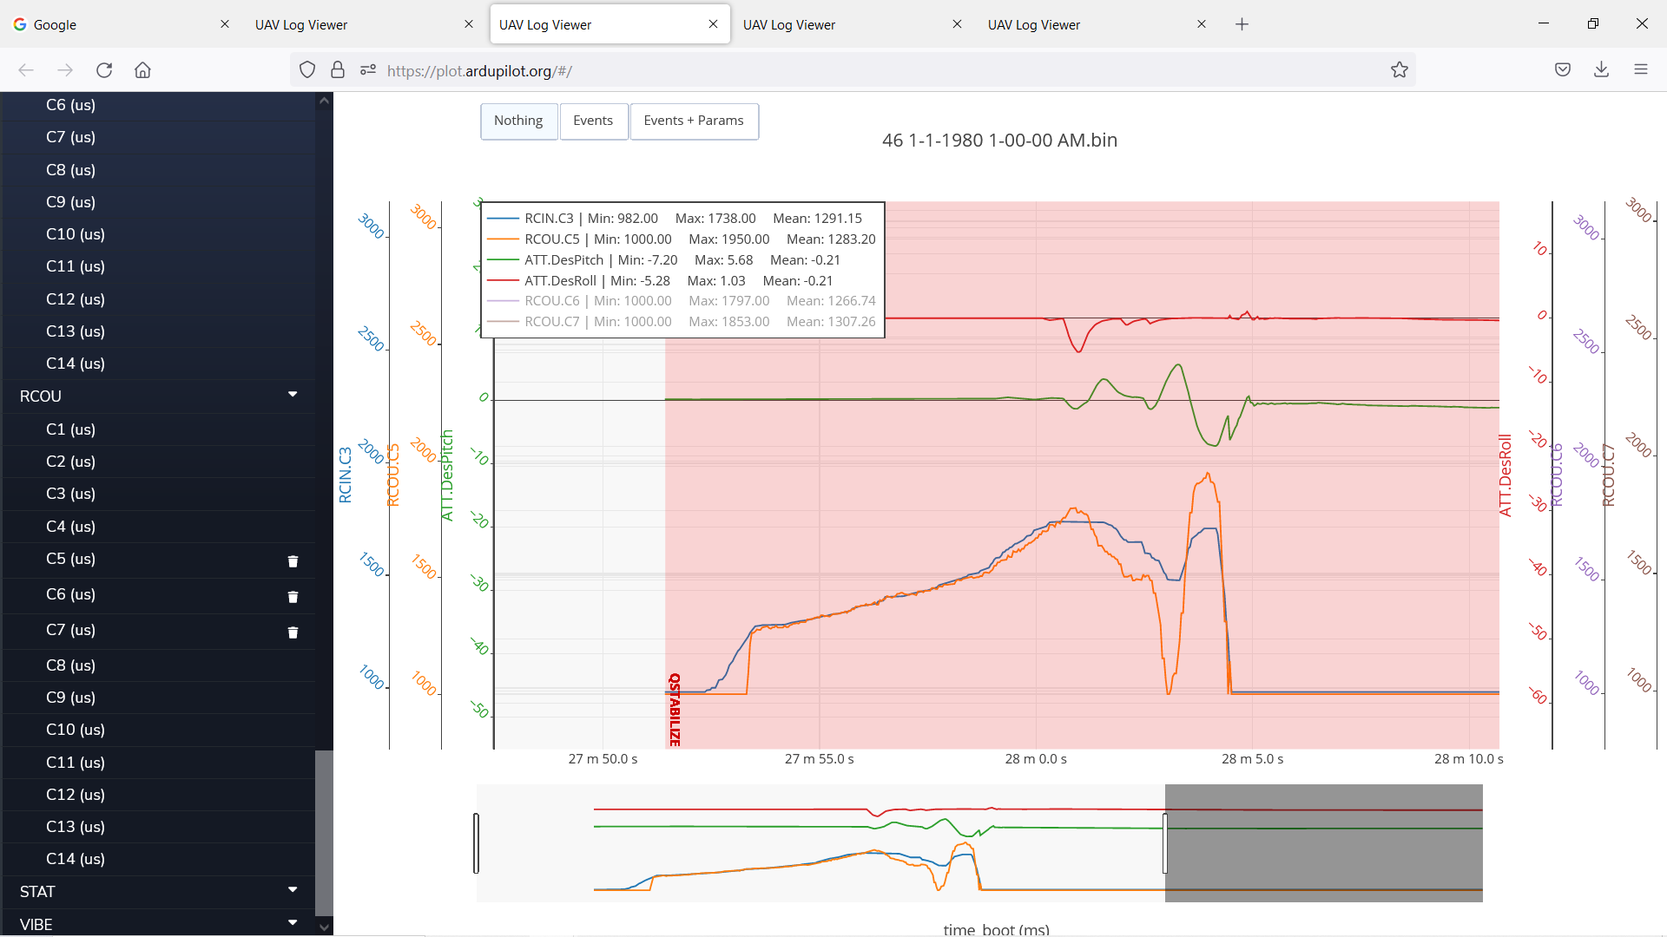
Notes:
Back Motor – Track Throttle – Track Inv DesPitch

Slide 3
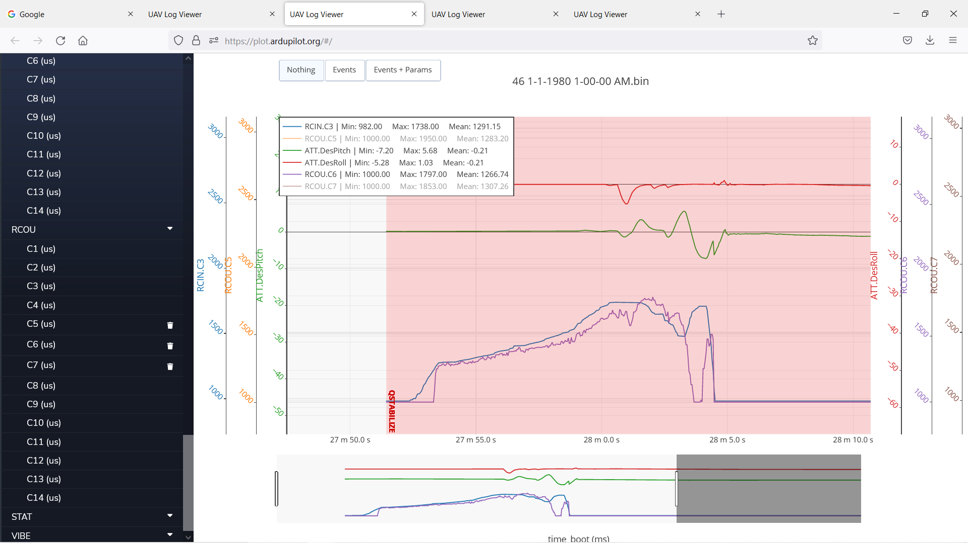
Notes:
Right Front Motor – Track Throttle – Track DesPitch – Track Inv DesRoll

Slide 4
Notes:
Left Front Motor – Track Trottle –Track DesPitch – Track DesRoll

