Slide 1
PID - Test 25 - Old9 folder – 4_17.bin
Pitch: P=1.0, I=0.02, D=0.01

Slide 2
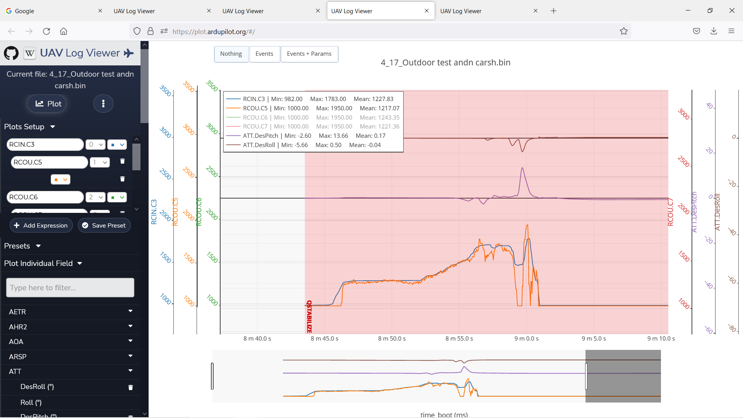
Notes:
Back Motor – Track Throttle – Track Inv DesPitch

Slide 3
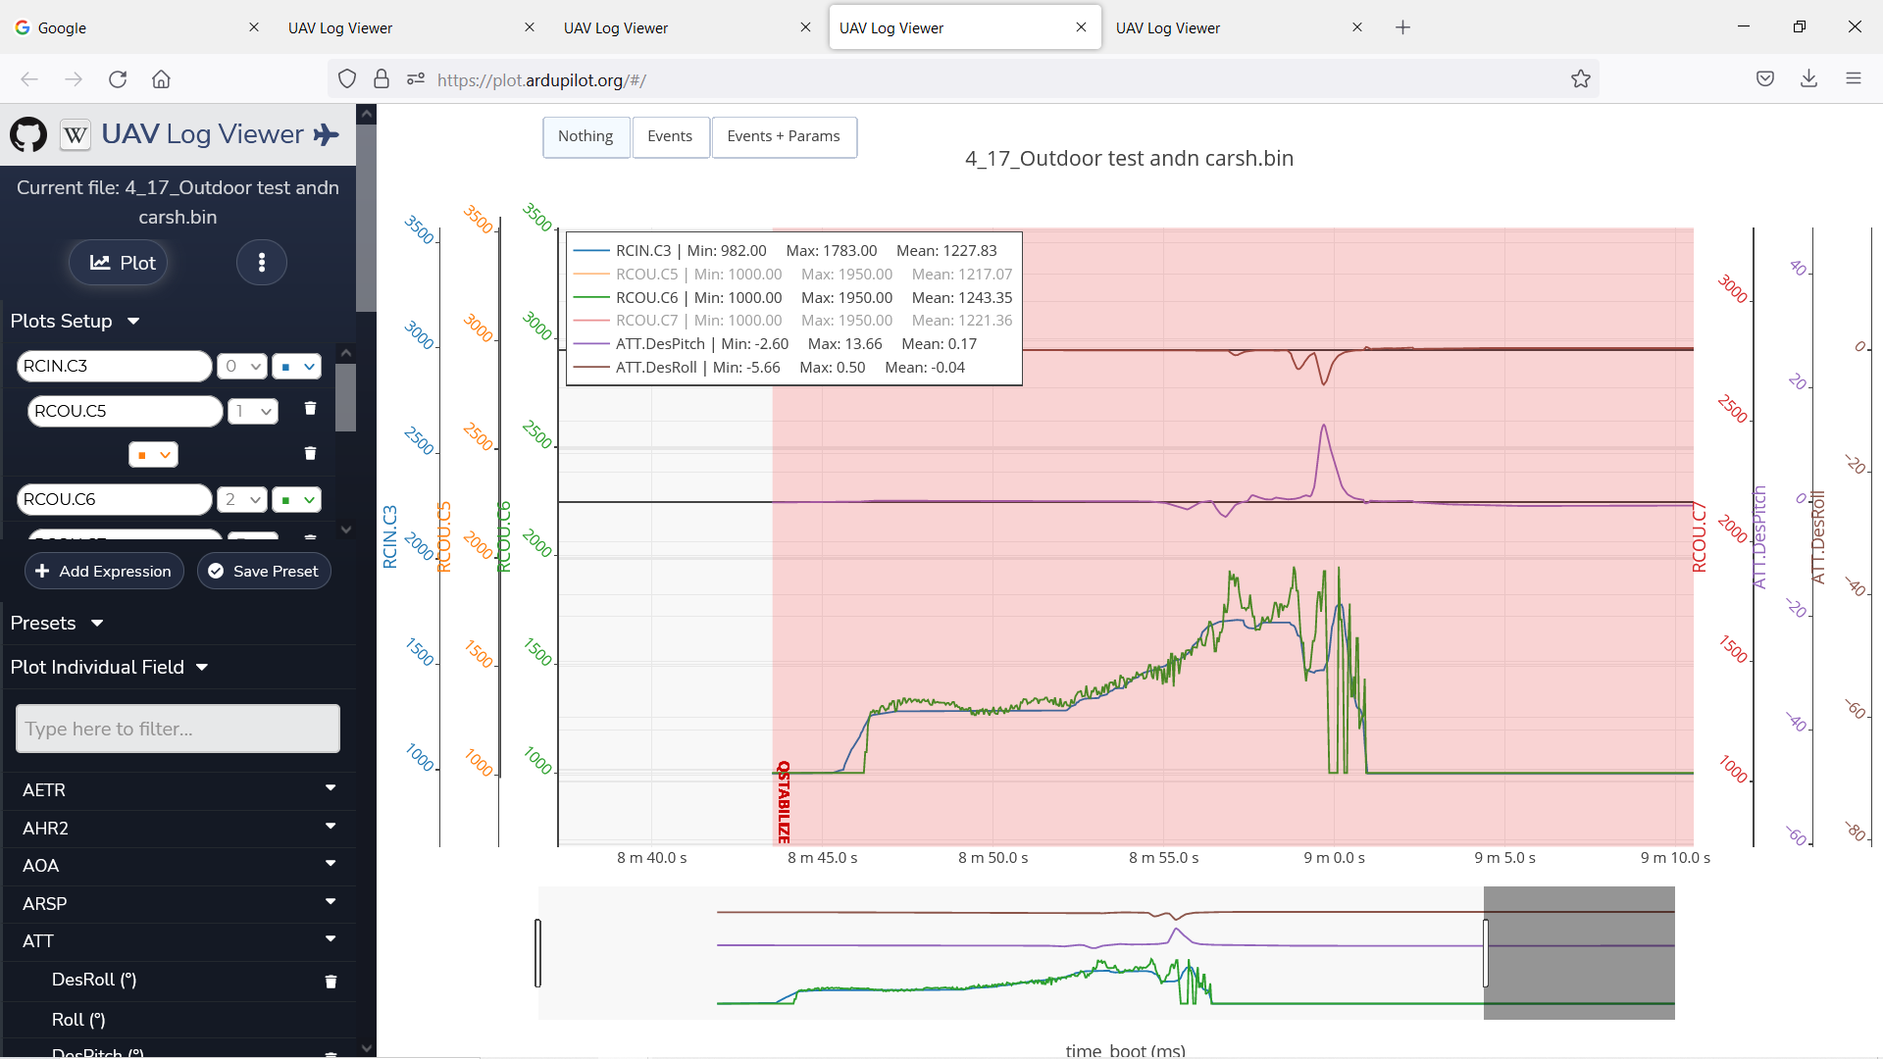
Notes:
Right Front Motor – Track Throttle – Track DesPitch – Track Inv DesRoll

Slide 4
Notes:
Left Front Motor – Track Trottle –Track DesPitch – Track DesRoll

